Slide 1
Build out Line
SJSL Guidelines

Slide 2
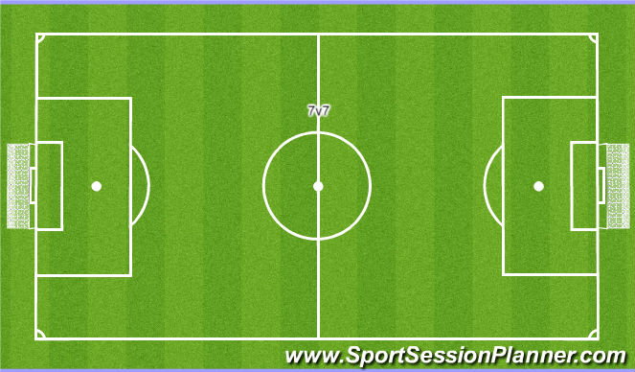
U8-U10 Field Build Out Lines

Slide 3
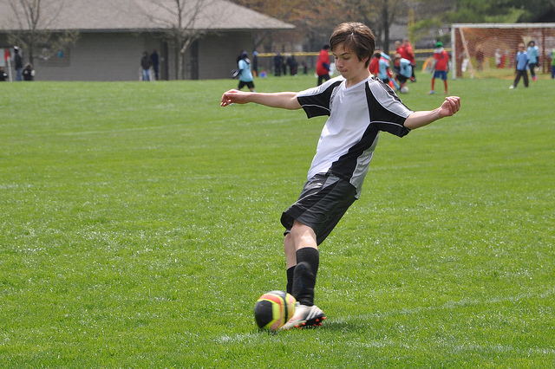
Located halfway between the top of the penalty area and midfield (Must be clearly marked on the field; you cannot use cones!)
The build out line is used to promote playing the ball out of the back in an unpressured setting.
When the goalkeeper has the ball for a goal kick, the opposing team must move behind the build out line.

Slide 4
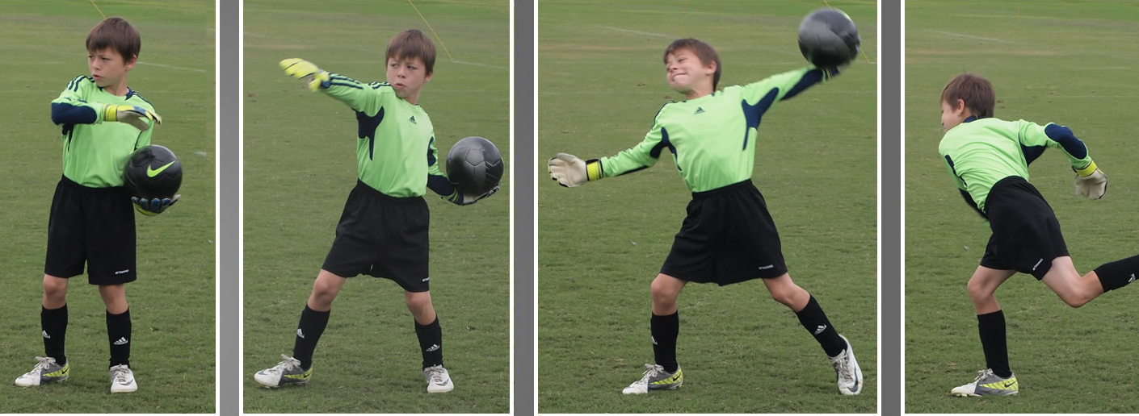
When the goalkeeper has the ball during play (from the opponent), the opposing team must move outside the build out line.
6 secs starts after opposing team is behind line
Cannot recross line until ball is “in play”
Ball is in play when it leaves the goal keeper’s possession (rolled, thrown or passed)

Slide 5
Answers to Common Questions
Offside- The build out line on the attacking half of the midfield line for each team will be used to determine offside.
Who Moves- Only the opposing team is required to move beyond the build out line.
Delay- You can be cautioned for failure to timely move back past the build out line for “Delay of restart”.
Punt/Drop Kick- If a GK punts or drop kicks the ball, an indirect free kick will be awarded to the opponent at the spot of the infraction.

Slide 6
Answers to Common Questions
Early Play- If the GK releases the ball before all of the opponents move beyond the build out line - play on.
Throws- The GK may throw the ball beyond the build out line.
Goal Kick- Opponents must be beyond the build out line for goal kicks and cannot touch the ball until it clears the penalty area or is touched by a second player on the kicking team.
Kicking- After a save, GKs may release the ball to the ground and then pass it.

Slide 7
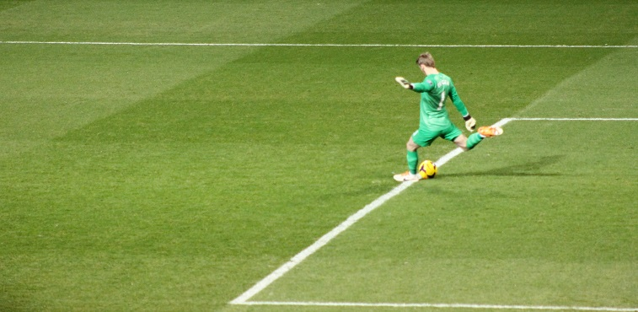
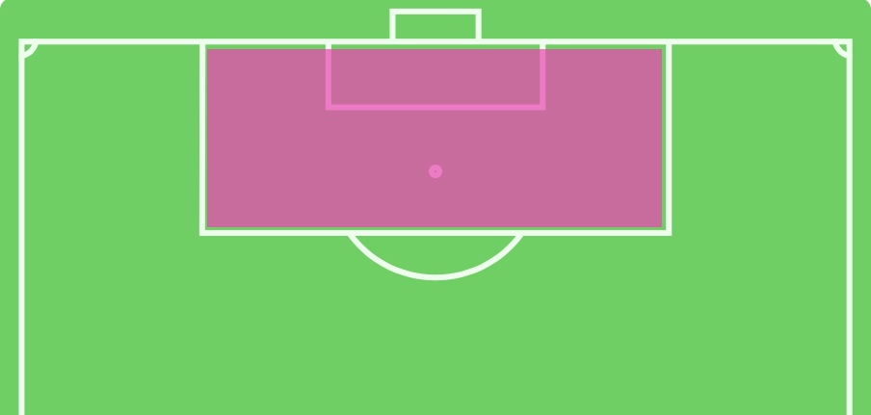
Don’t Be Confused!
For 7v7 matches:
Cannot cross the build out line until the ball:
Clears the penalty area, or
It is touched by a second player on the kicking team
For 9v9 matches:
Cannot enter the penalty area until the ball:
Clears the penalty area, or
It is touched by a second player on the kicking team
For 11v11 matches:
Cannot enter the penalty area until the ball:
Is kicked and clearly moves

